Slide 1
MTA Project Summary
Megan, Nastassia, Kate, and Brian

Slide 2
Overall Strategy
- Morning: EXITS
- Evening: ENTRIES
- Stops with most people AND near tech firms
Notes:
Kate:
We decided to divide up our volunteers time by putting 5 volunteers in 5 different stations in the morning and 5 volunteers in 5 stations in the evening
For mornings, we looked at which stations had the most EXITS since we assumed that people in the morning will be exiting at a station near their work
For evenings, we looked at which stations had the most ENTRIES since we assumed that people in the evening will be getting on at a station near their work to head home
After we sorted the stations by the number of people, we looked at which of those stations were closest to tech firms since that is our target audience

Slide 3
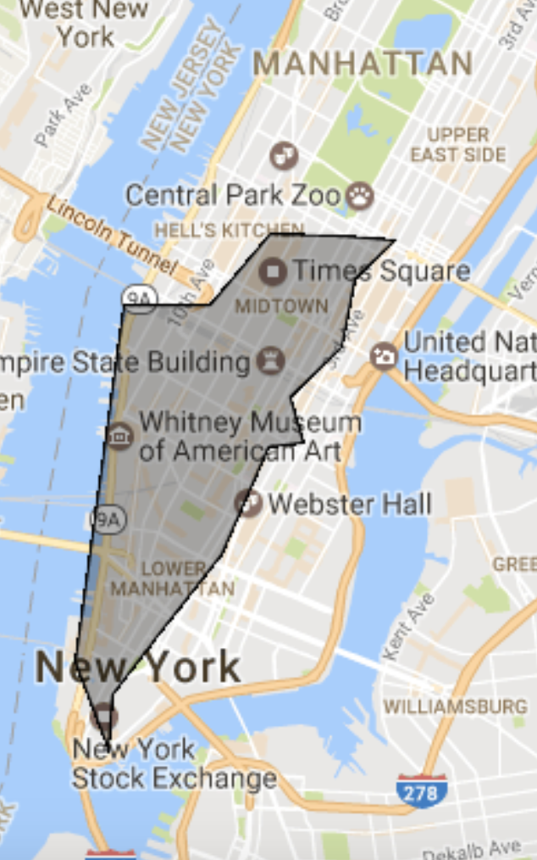
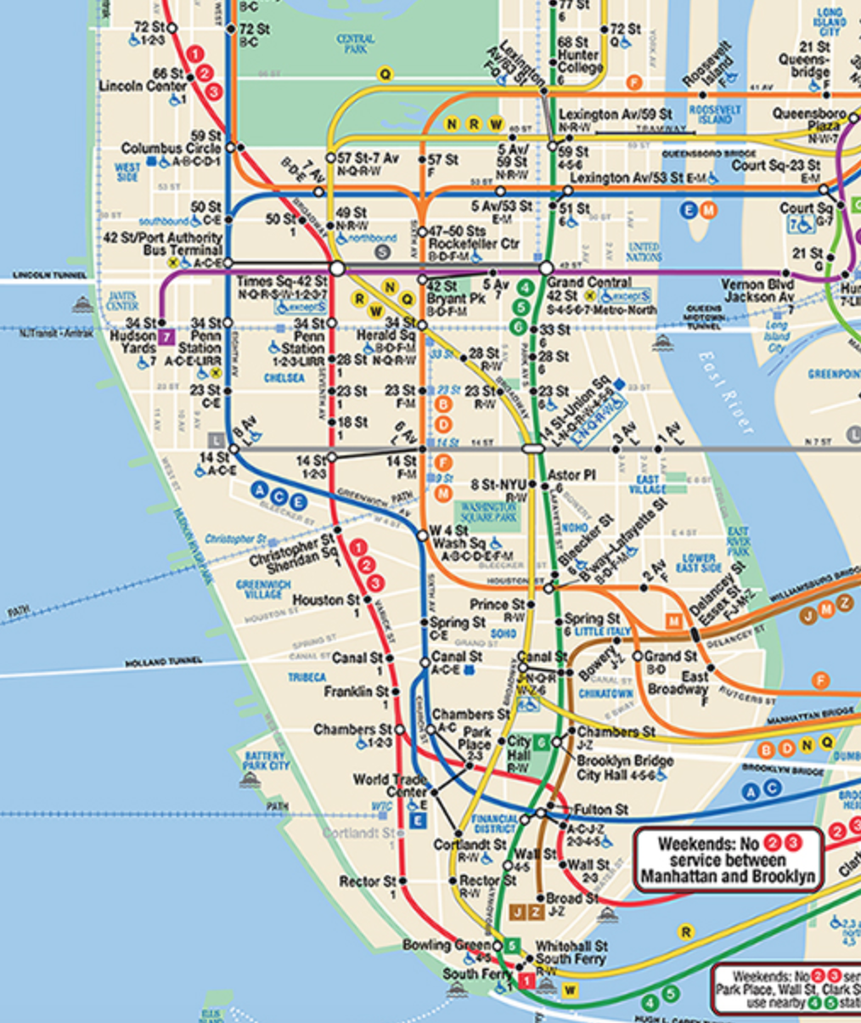
Tech Zone (96/100 Top companies)
Notes:
Megan talks
Matching up zones
Highest yield

Slide 4
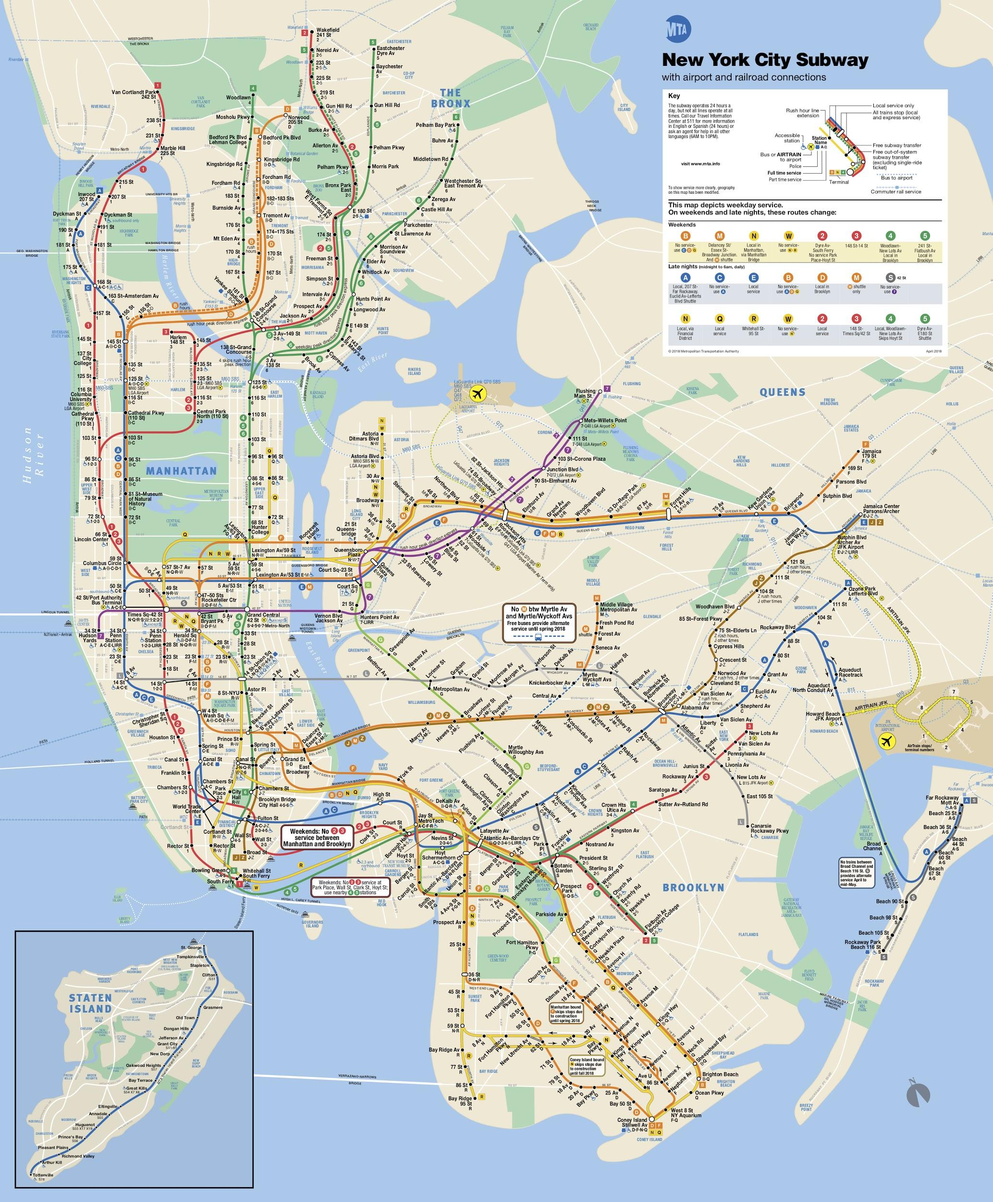
Monday and Tuesday
Notes:
To target the greatest amount of people, we decided to put one volunteer in each of five stations in the morning from 6-10 am and 1 person in five different stations in the evening from 4-8 pm
Based on our criteria of distinguishing which stations had the highest volume of people and that were nearest tech firms we chose the following stations for the morning (indicated by green arrows):
Grand central/42nd St
4750 STS Rock
Lexington Ave/53rd
42nd street/bryant park
5th ave/53rd st.
And the following stations for the evening (indicated by red arrows):
Grand Central 42nd St.
4750 STS rock
Lexington Ave/53rd
34th St. herald square
42nd st. bryant park

Slide 5
Wednesday and Thursday
Notes:
Nastassia *1 person stationed from 6-10 am at each of the exits, and 1 person stationed from 4-8 pm at each of the entries
Morning:
34th/Herald Square
Times Square/42nd st
Chambers st.
50th st.
Fulton st.
Evening:
34th/Herald Square
Times Square/42nd st
Chambers st.
50th st.
World Trade Center

Slide 6
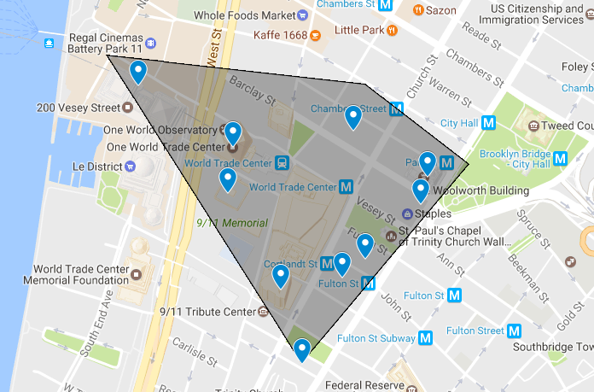
Friday
Notes:
Nastassia -Targeted Universities and highest density technological area stops. In total, 10 percent of the largest employers are located within a couple of blocks of One World Trade Center, representing a 0.1 square mile area (area in grey) *Stationed from 6-10 am at the stops near tech firms, 8am-12pm at the colleges. 4-8 pm tech firms, 5-9pm colleges.
Morning and evening stops:
Cortlandt St (shown on map)
Park Place (shown on map)
116th/Columbia University
Hoboken PATH
8th st (Closest to NYU)

Slide 7
Saturday
Notes:
Megan-8-12 am mornings, 5-9 pm evenings
Morning:
Grand central
Flushing main
Bedford Ave
59th st. columbus
86th st.
Evening:
Bedford Ave
34th st. Herald sq.
Grand central 42nd st.
Flushing main
Jackson HT Roosevelt

Slide 8
Sunday
Notes:
Brian-(8-12 for mornings)-(5-9 for evenings)
Morning:
Grand central/42nd
Flushing main
Bedford Ave
59 st. columbus
86th
Evening:
Grand Central 42nd st
Bedford ave
34th st. Herald sq
Flushing main
Times sq. 42nd

Slide 9
Why you should choose us
- Future innovators
- Data for ALL times, not just beginning of hour
- Most stations in tech bubble
- Targeted 20 stations
Notes:
Brian
-We considered future innovators in our targeting campaign
-We not only considered times recorded at the beginning of an hour, but times in between as well
-We targeted the largest possible interested audience by choosing popular stops near technological firms
-We targeted an ideal number of stops by stationing people at stops for no more than two days

